Slide 1

Team
Mortality
Probability
CAPSTONE PROJECT Summer 2018
P(Mortality)

Slide 2
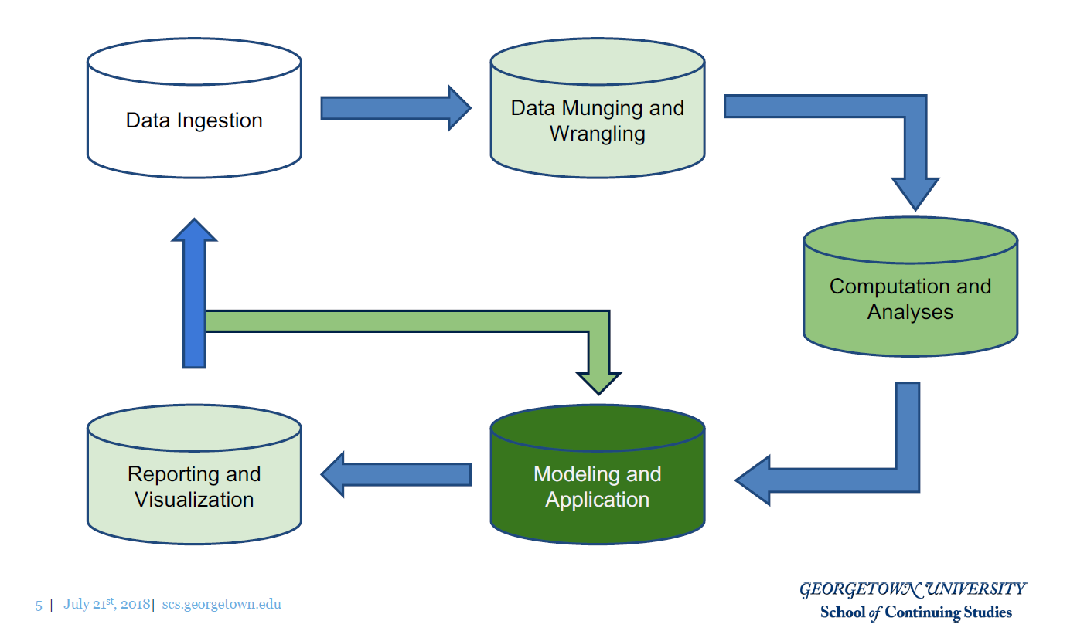
Framework

Slide 3
Agenda
Introduction
“Unwrangled” Data
Preliminary Analysis
Wrangled Data
Machine Learning
Visualization
Conclusion

Slide 4
Introduction
5 member project team
National Longitudinal Mortality Study (NLMS)
National Heart, Lung, and Blood Institute
National Cancer Institute
National Institute on Aging
National Center for Health Statistics
U.S. Census Bureau
NLMS Public Use Microdata Sample (PUMS)
Three 6-year follow up files
One 11-year follow up file
One tobacco-use follow up file
Privacy implications addressed
}
All .csv files

Slide 5
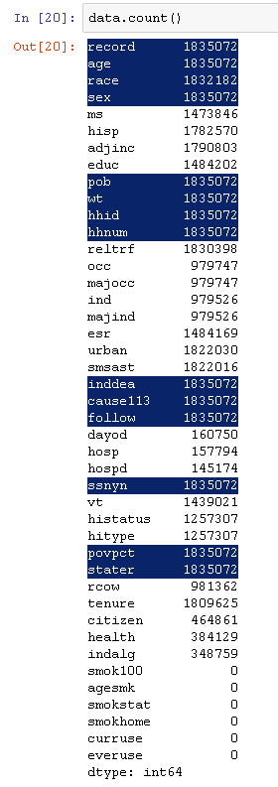
Data
Subset of 39 NLMS cohorts from throughout the 1980s and 1990s
Each record includes demographic & socioeconomic variables combined with a mortality outcome (inddea)
Underlying cause & follow-up time have been provided for deaths (“Leakage”)
1,835,072 records
43 Attributes
Smoking-related (6) have no observations
ᵡ
ᵡ

Slide 6
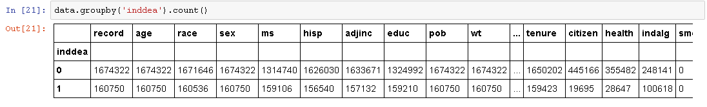
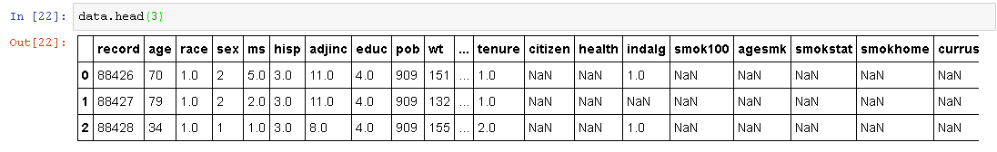
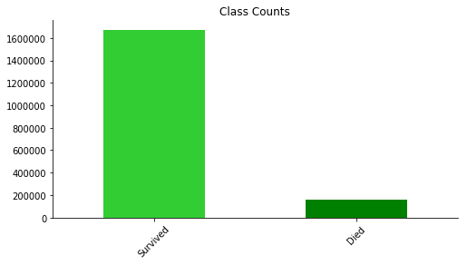
Data (cont.)
Imbalanced Dataset (~ 91% : 9%)
Mix of continuous, binary and categorical data

Slide 7
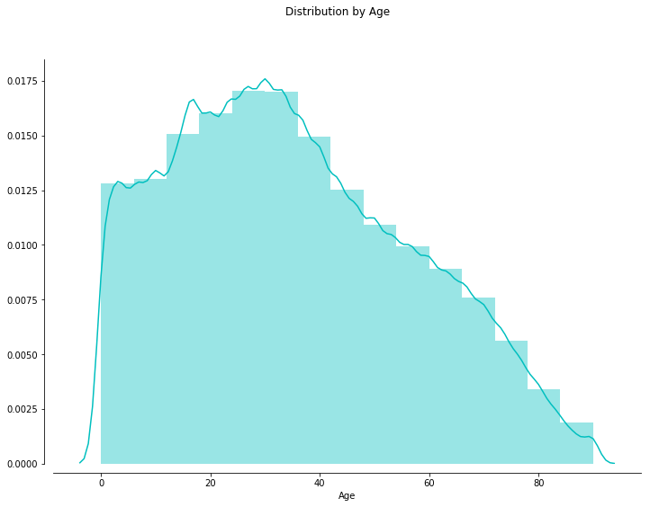
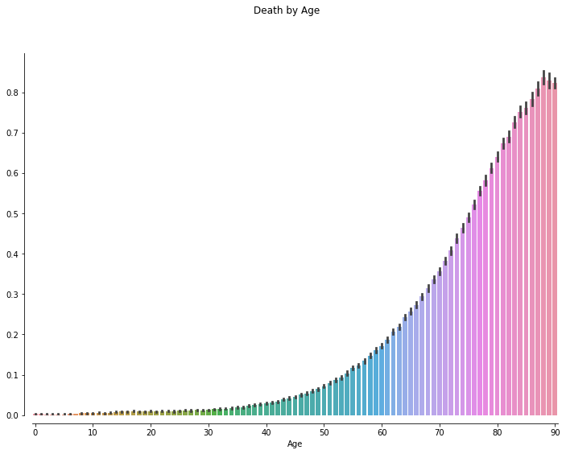
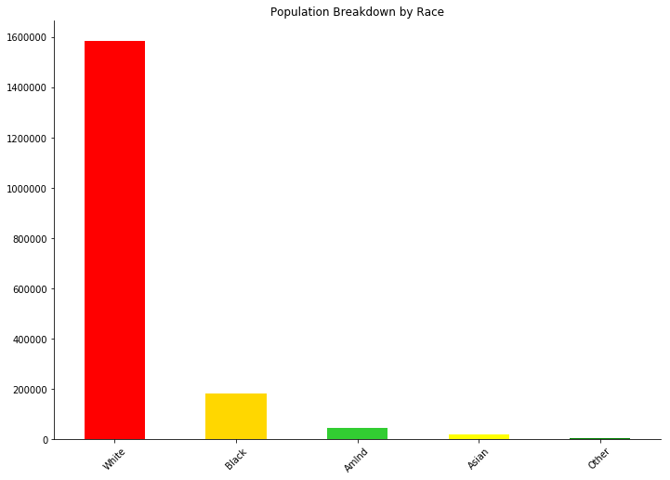
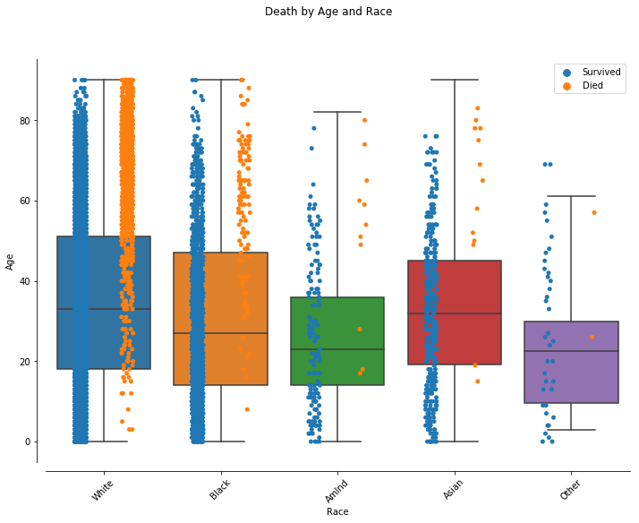
Preliminary Analysis

Slide 8
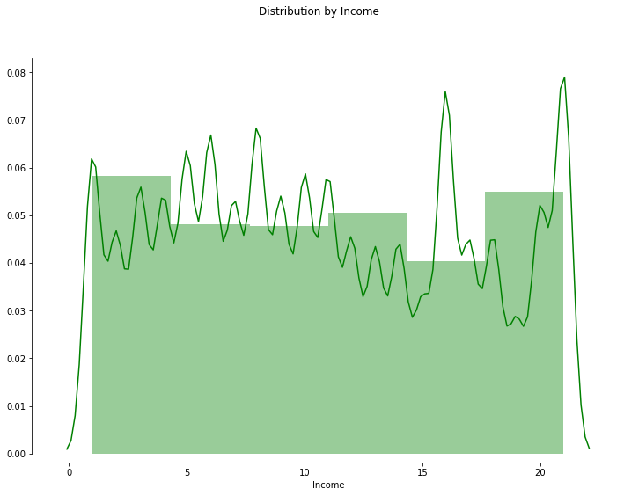
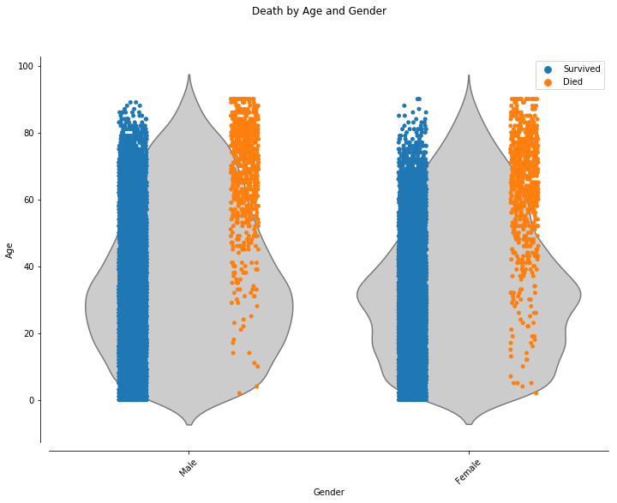
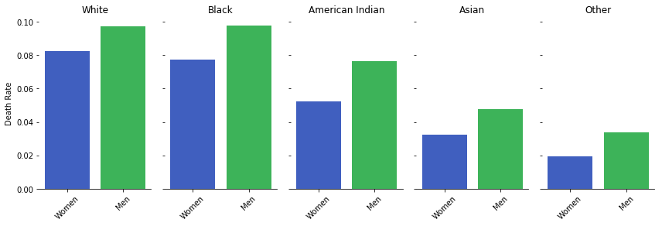
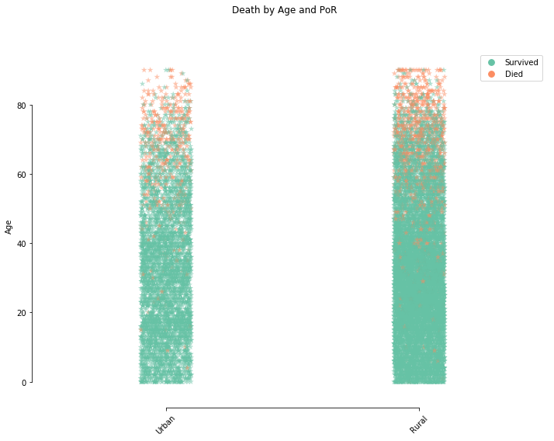
Preliminary Analysis (cont.)

Slide 9
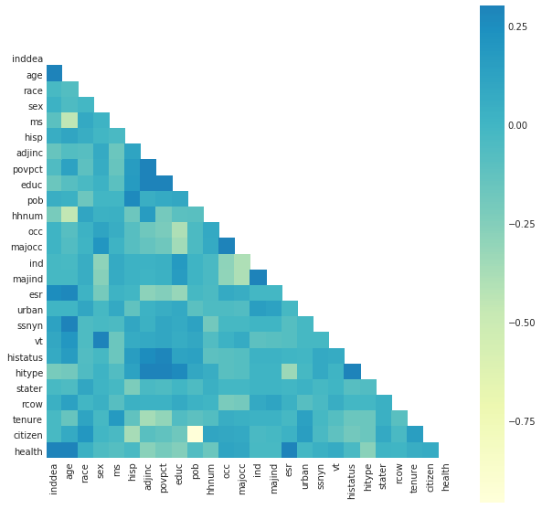
Preliminary Analysis (cont.)

Slide 10
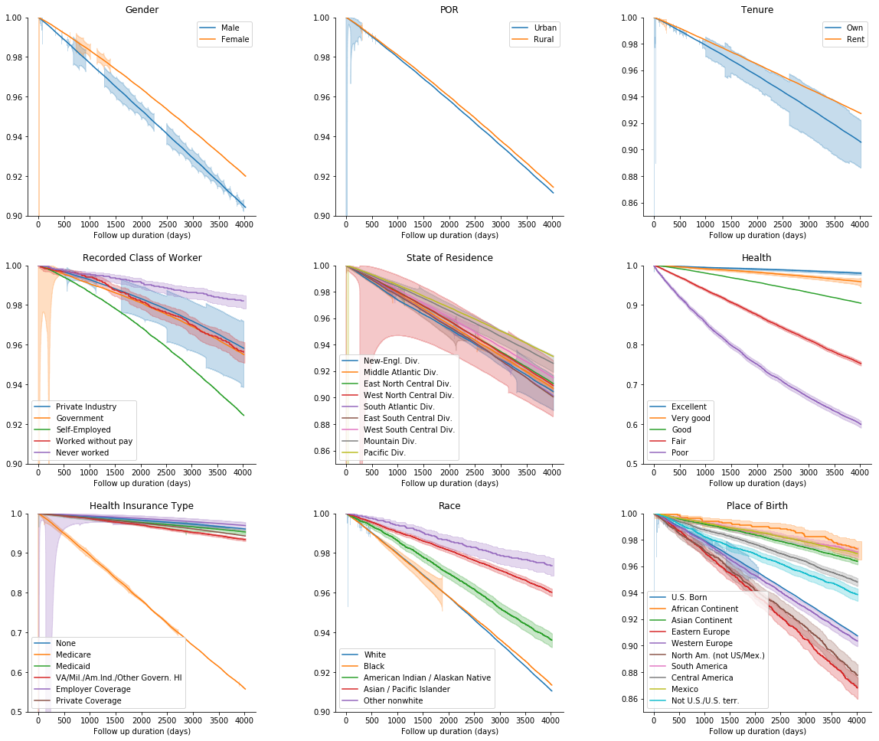
Kaplan-Meier

Slide 11
Wrangling
Made all binary variables = (0, 1)
Created bins for variables with multiple values
Dropped variables w/ missing data, bias and/or low correlation with inddea
Dropped rows w/ missing data
Generated dummy variables for 5 hierarchical variables
Wrangled dataset ended up with 40 dependent variables and 1,012,172 instances
Split dataset into train & test (80/20)

